Slide 1
CUSTOMER RELATIONSHIP MANAGEMENT SYSTEM (CRM) (capstone – 2)
DONE BY: T.SASHIDHAR

Slide 2
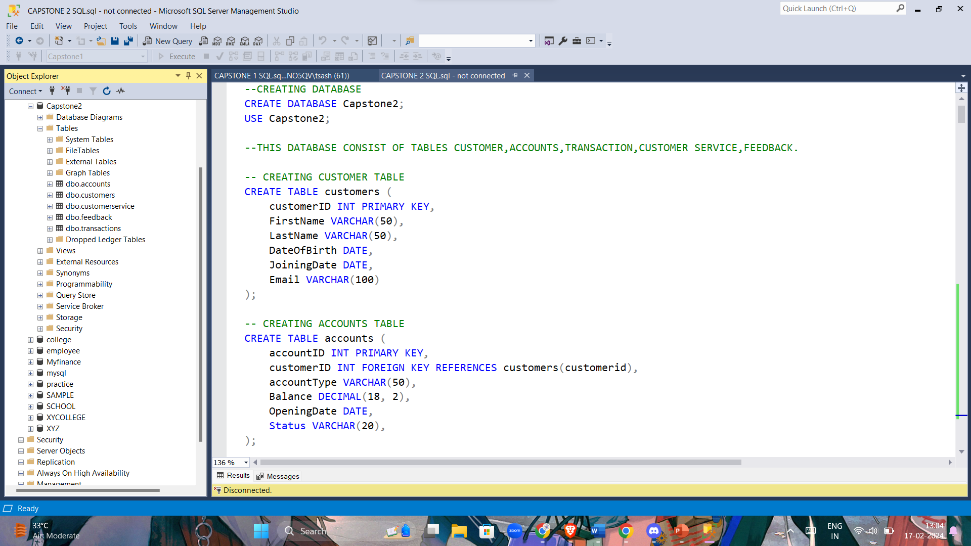
Create tables for customers, accounts, transactions, and customer service interactions with appropriate data types and constraints.

Slide 3
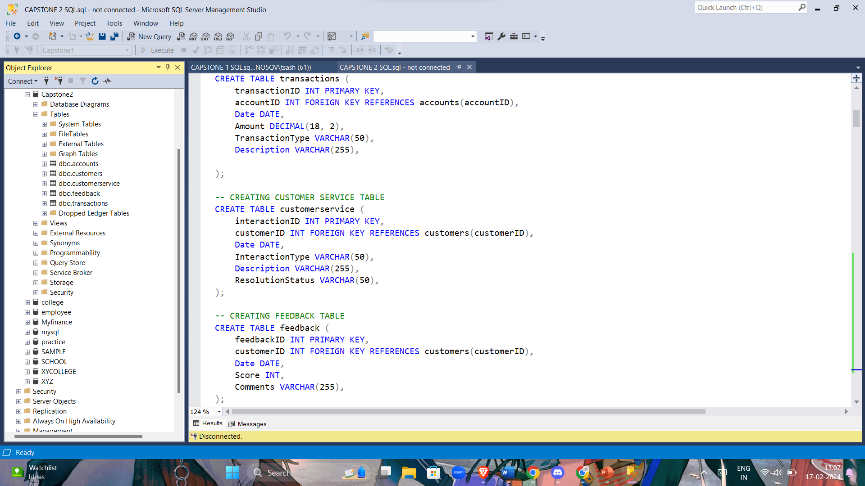

Slide 4
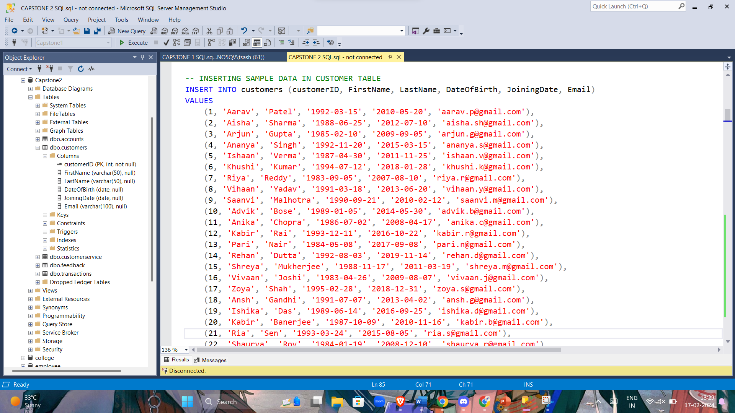
Insert sample data into each of the tables created. keep data with minimum of 30 -40 rows

Slide 5
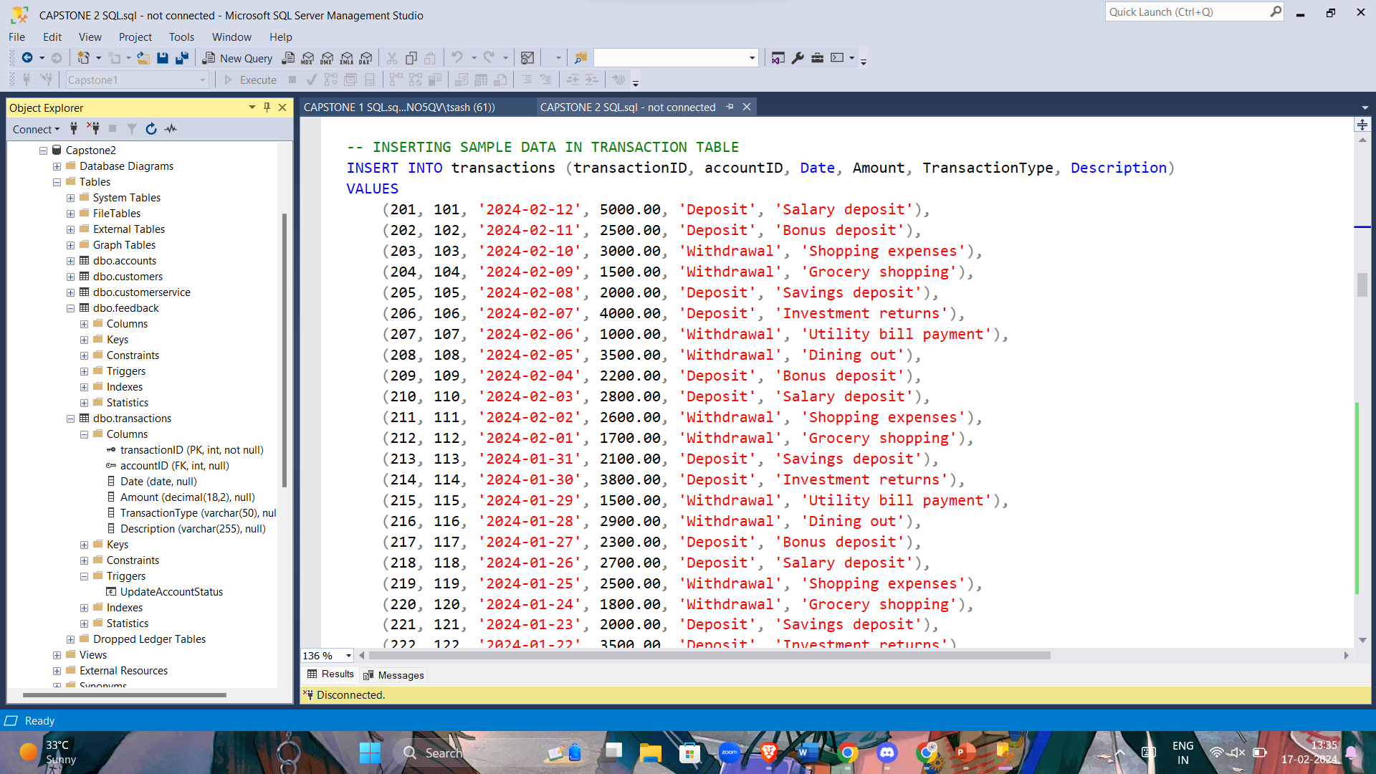

Slide 6
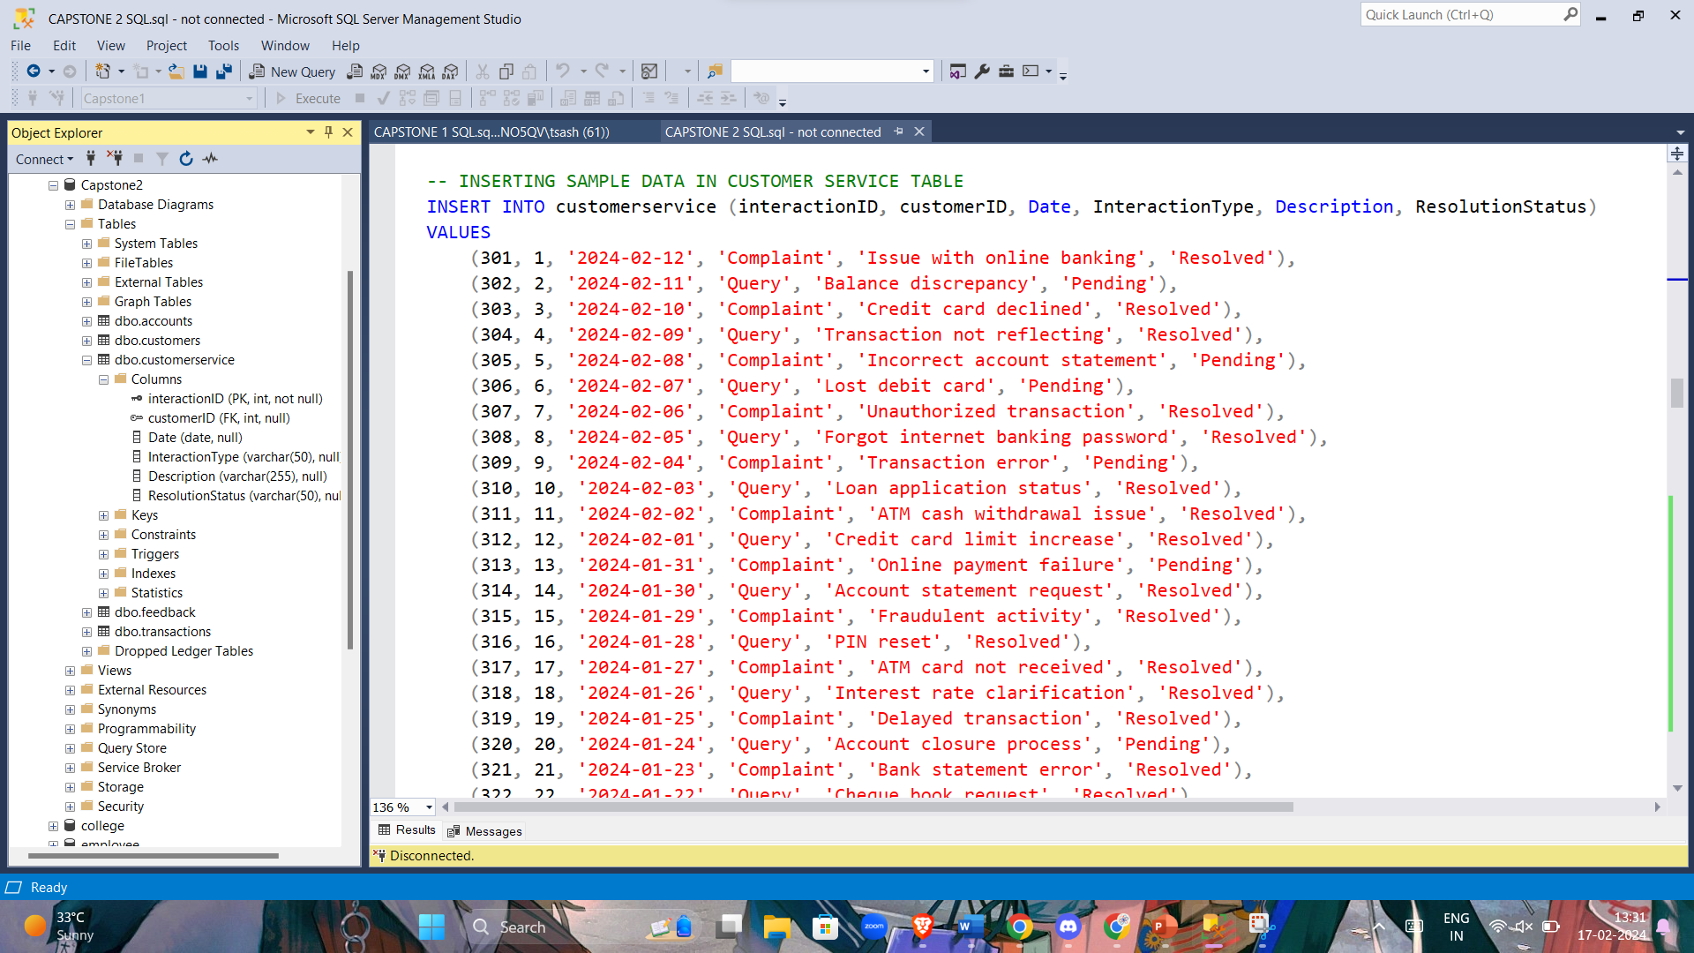

Slide 7
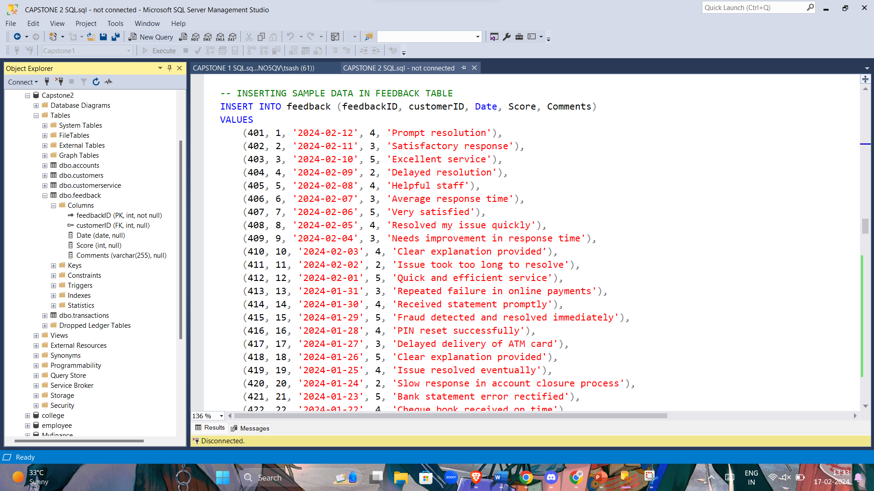

Slide 8
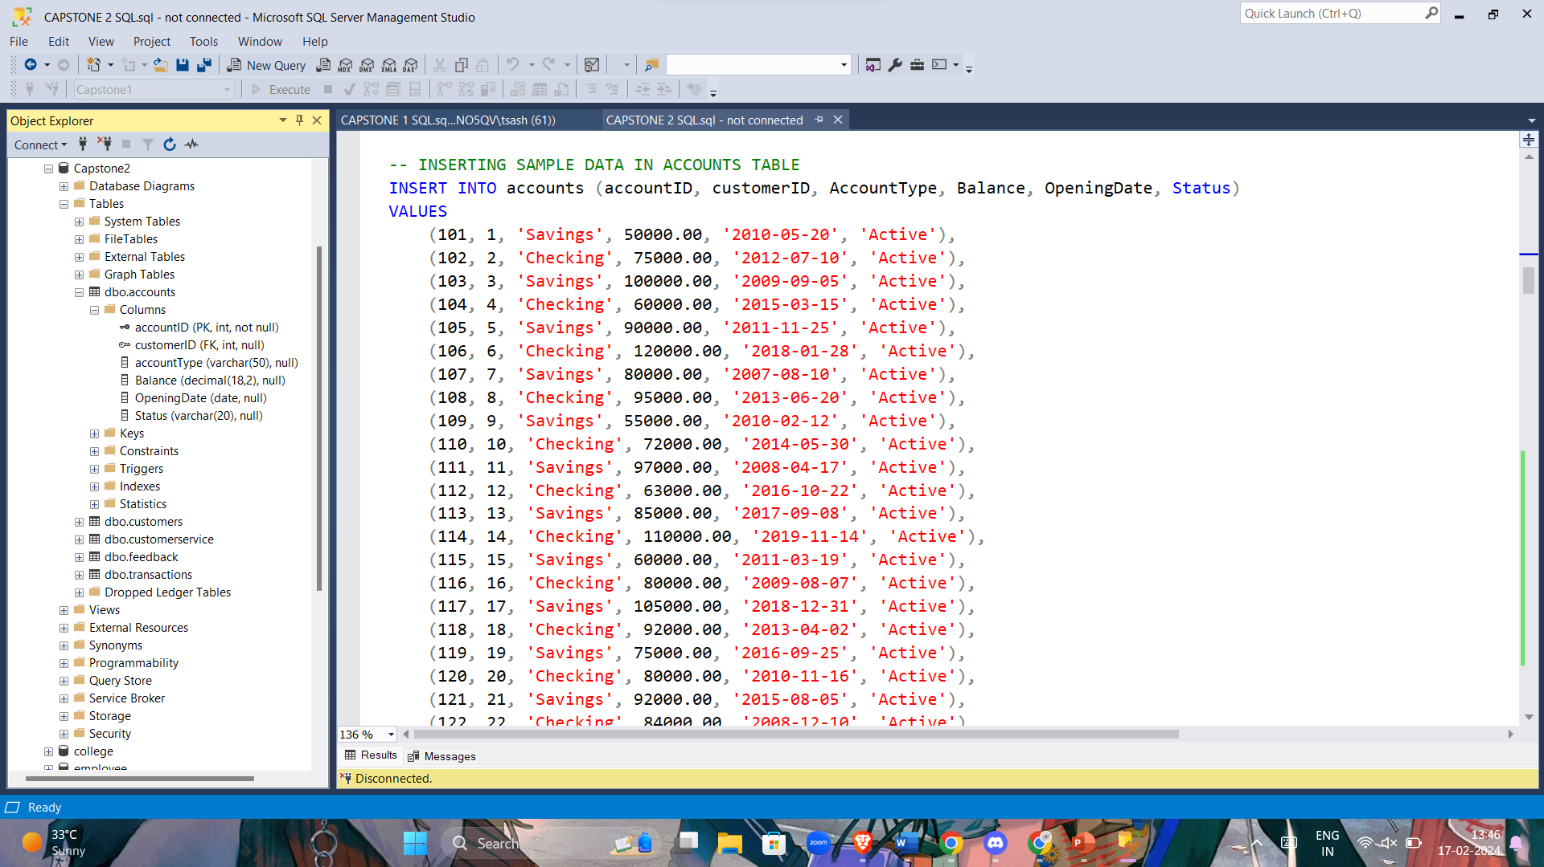

Slide 9
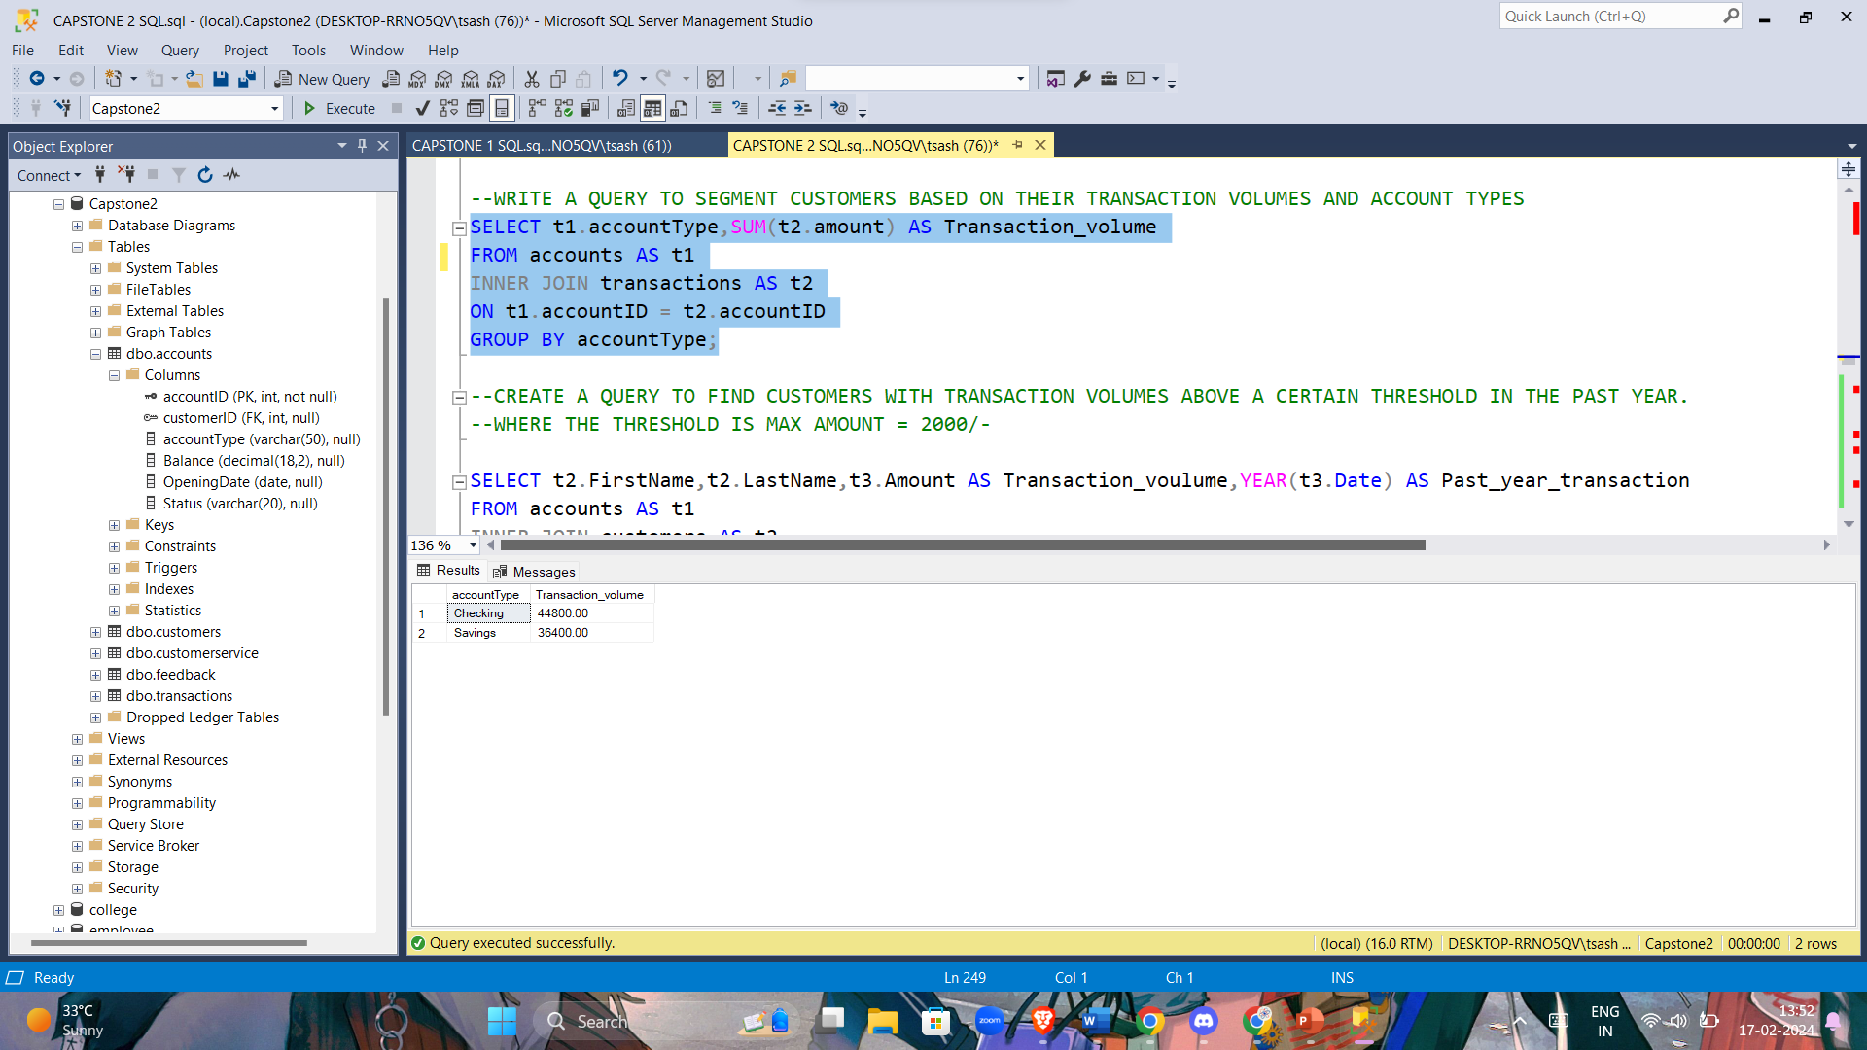
Write a query to segment customers based on their transaction volumes and account types.

Slide 10
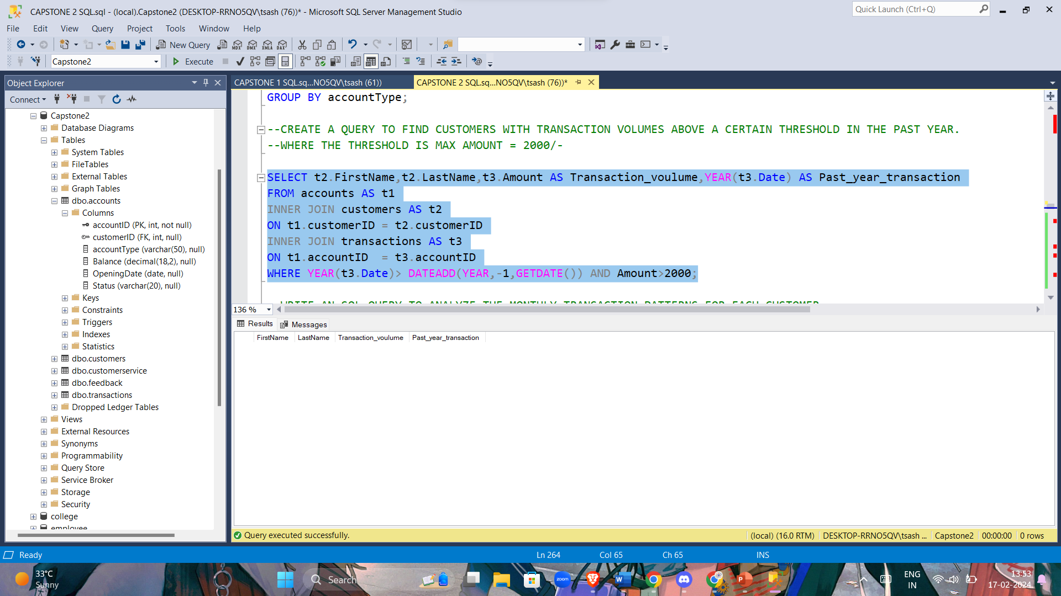
Create a query to find customers with transaction volumes above a certain threshold in the past year. where the threshold is max amount = 2000

Slide 11
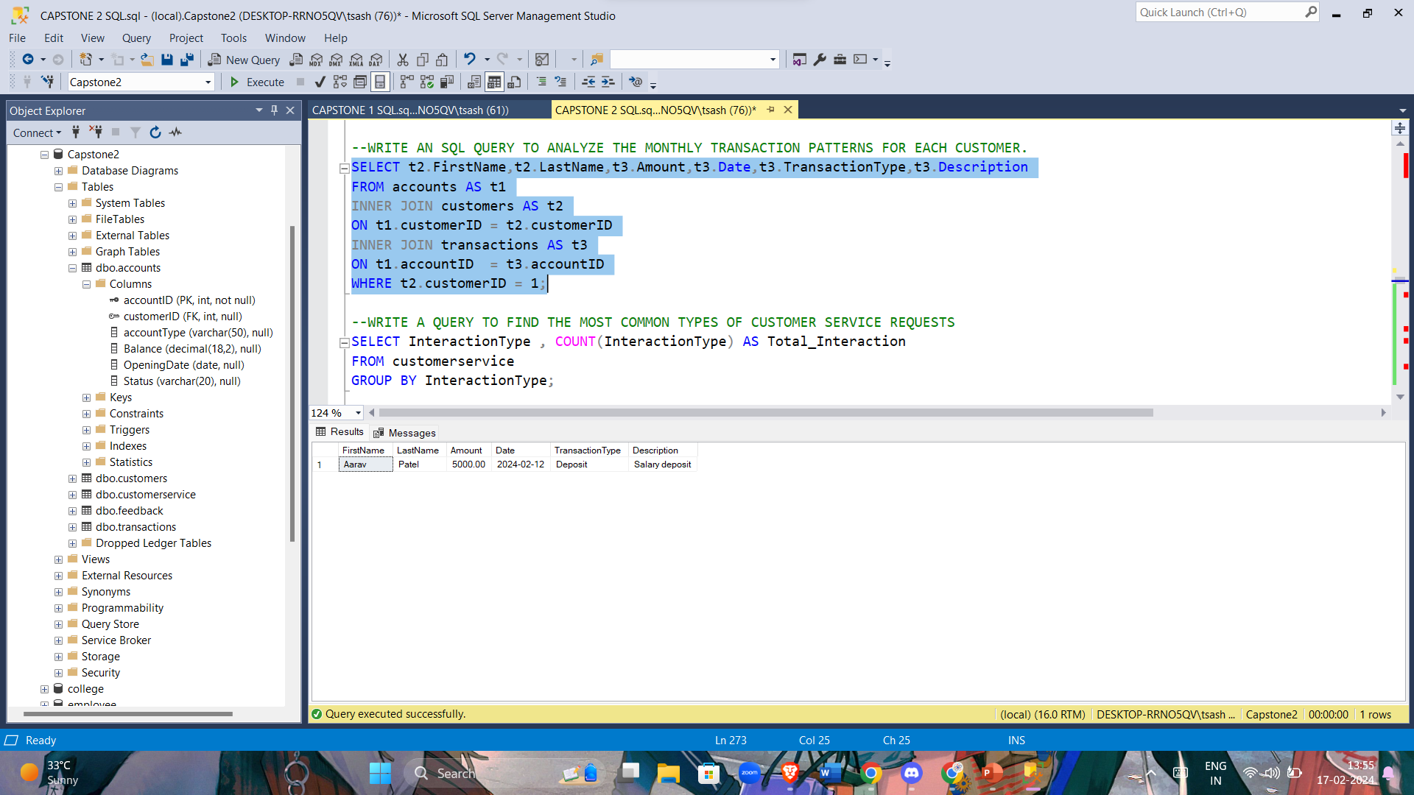
Write an SQL query to analyze the monthly transaction patterns for each customer.

Slide 12
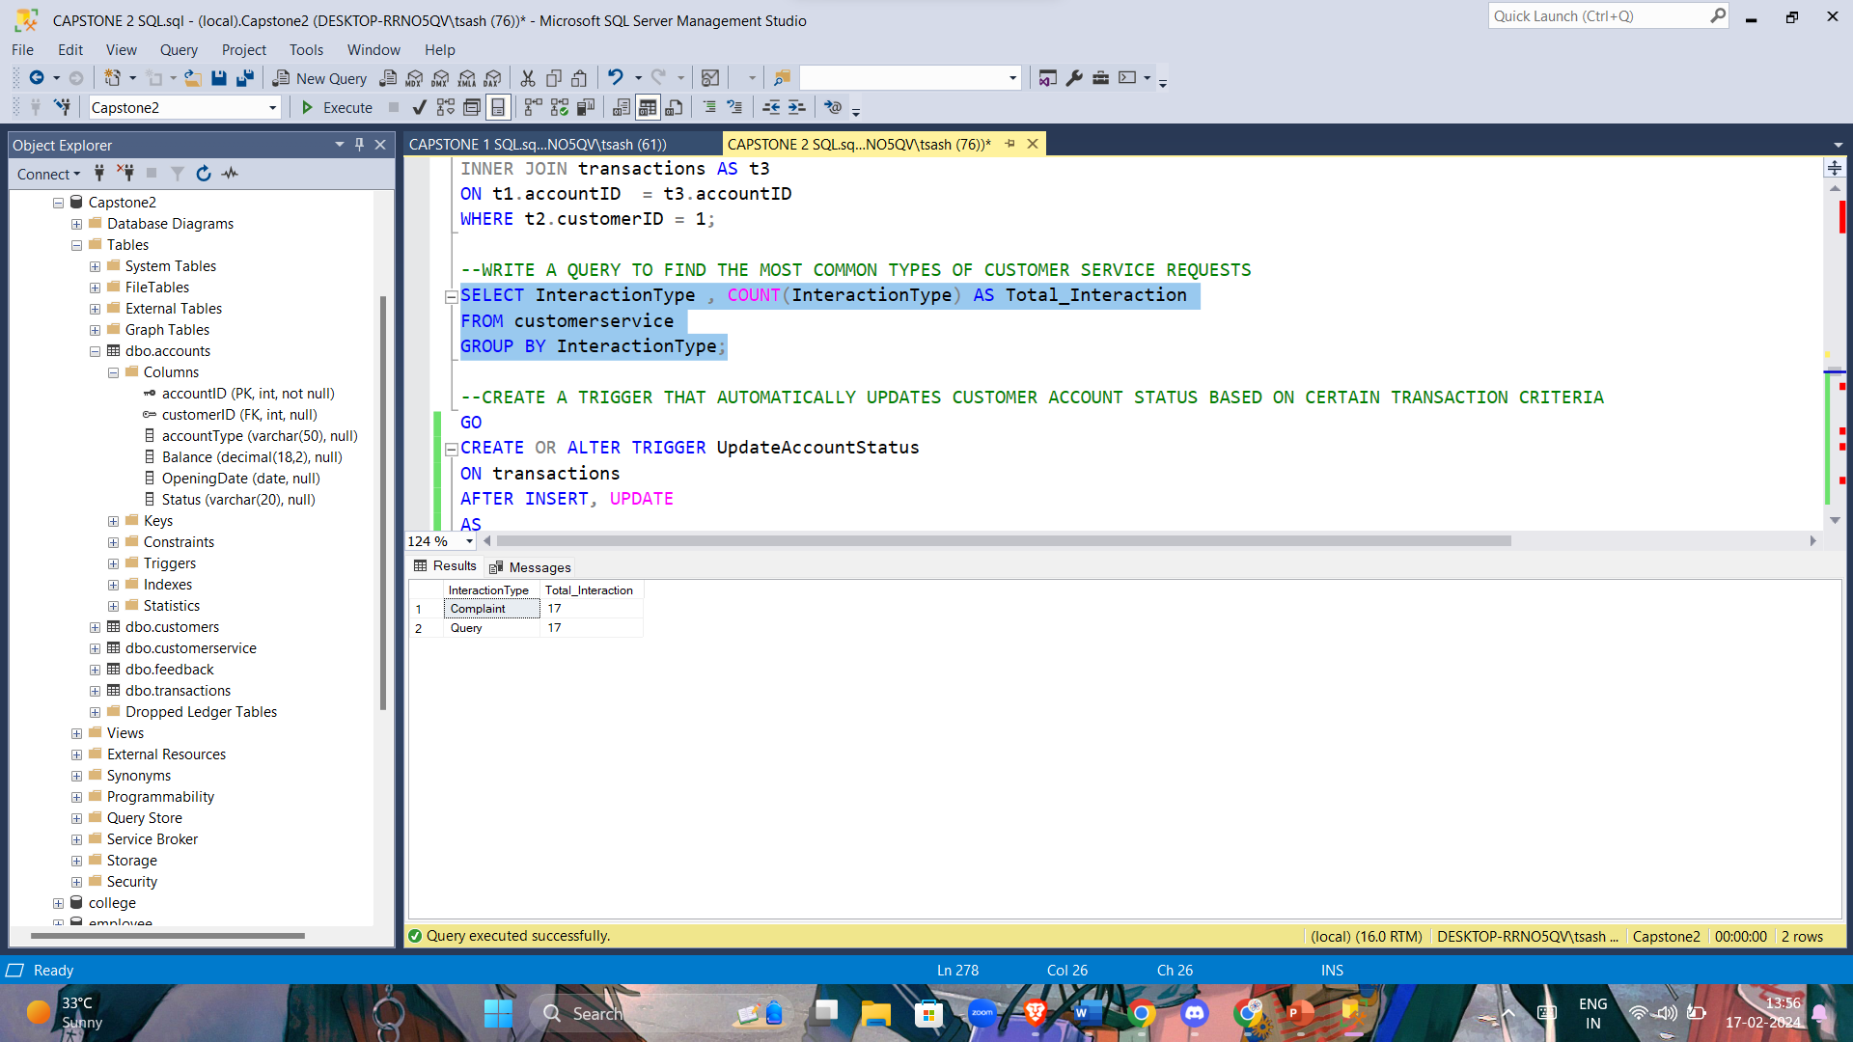
Write a query to find the most common types of customer service requests.

Slide 13
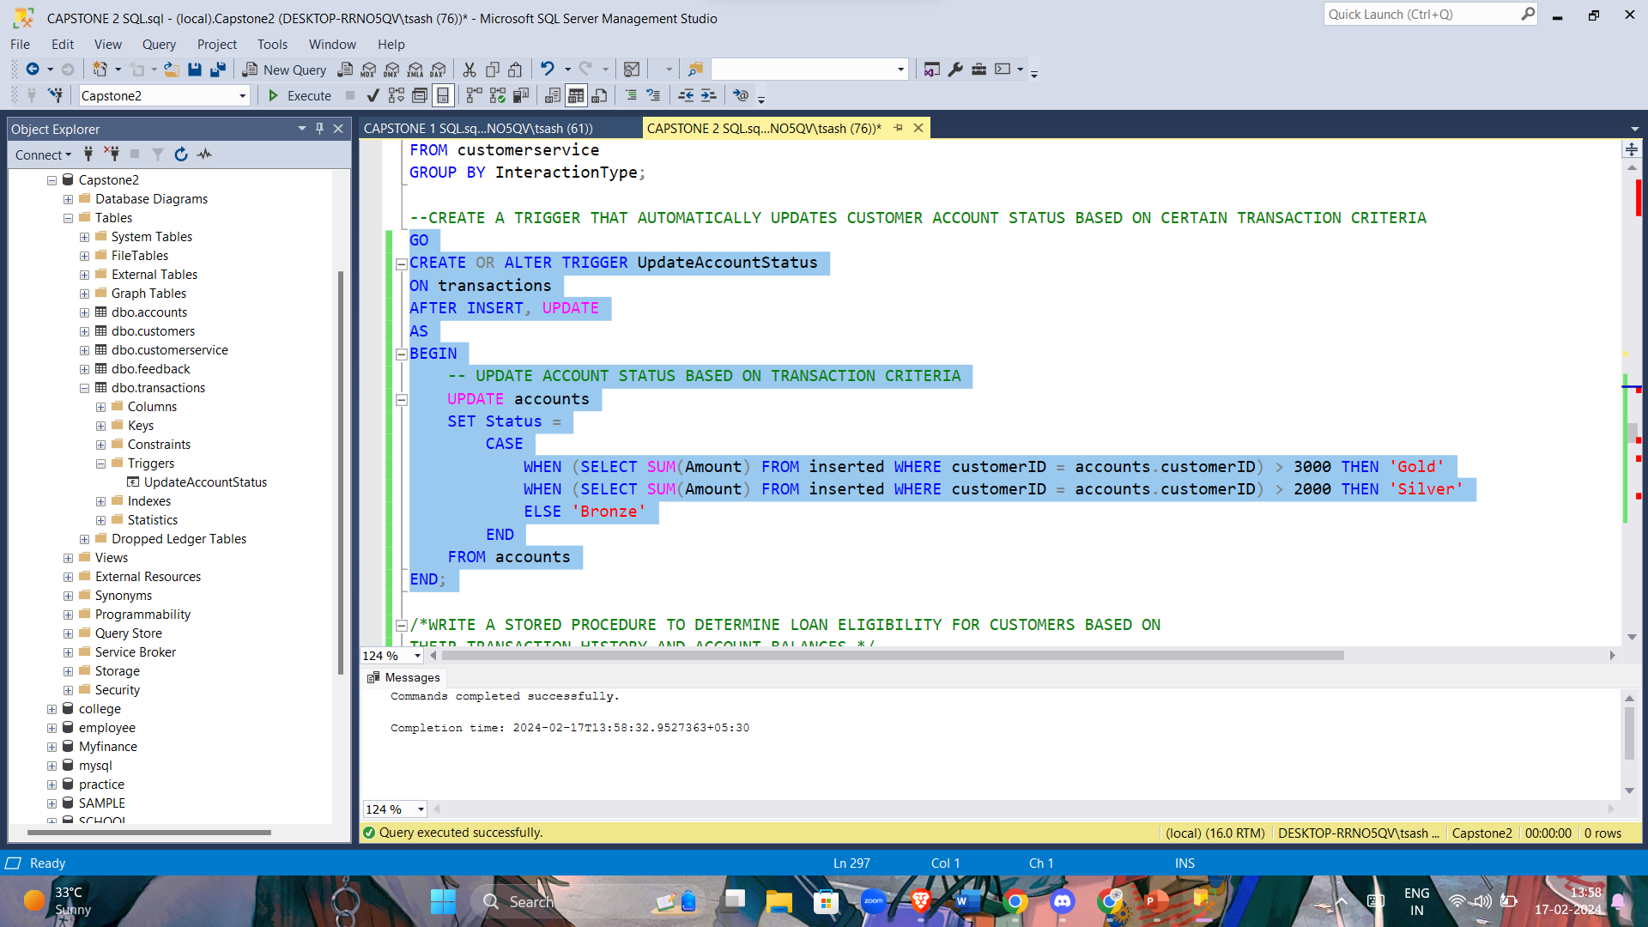
Create a trigger that automatically updates customer account status based on certain transaction criteria

Slide 14
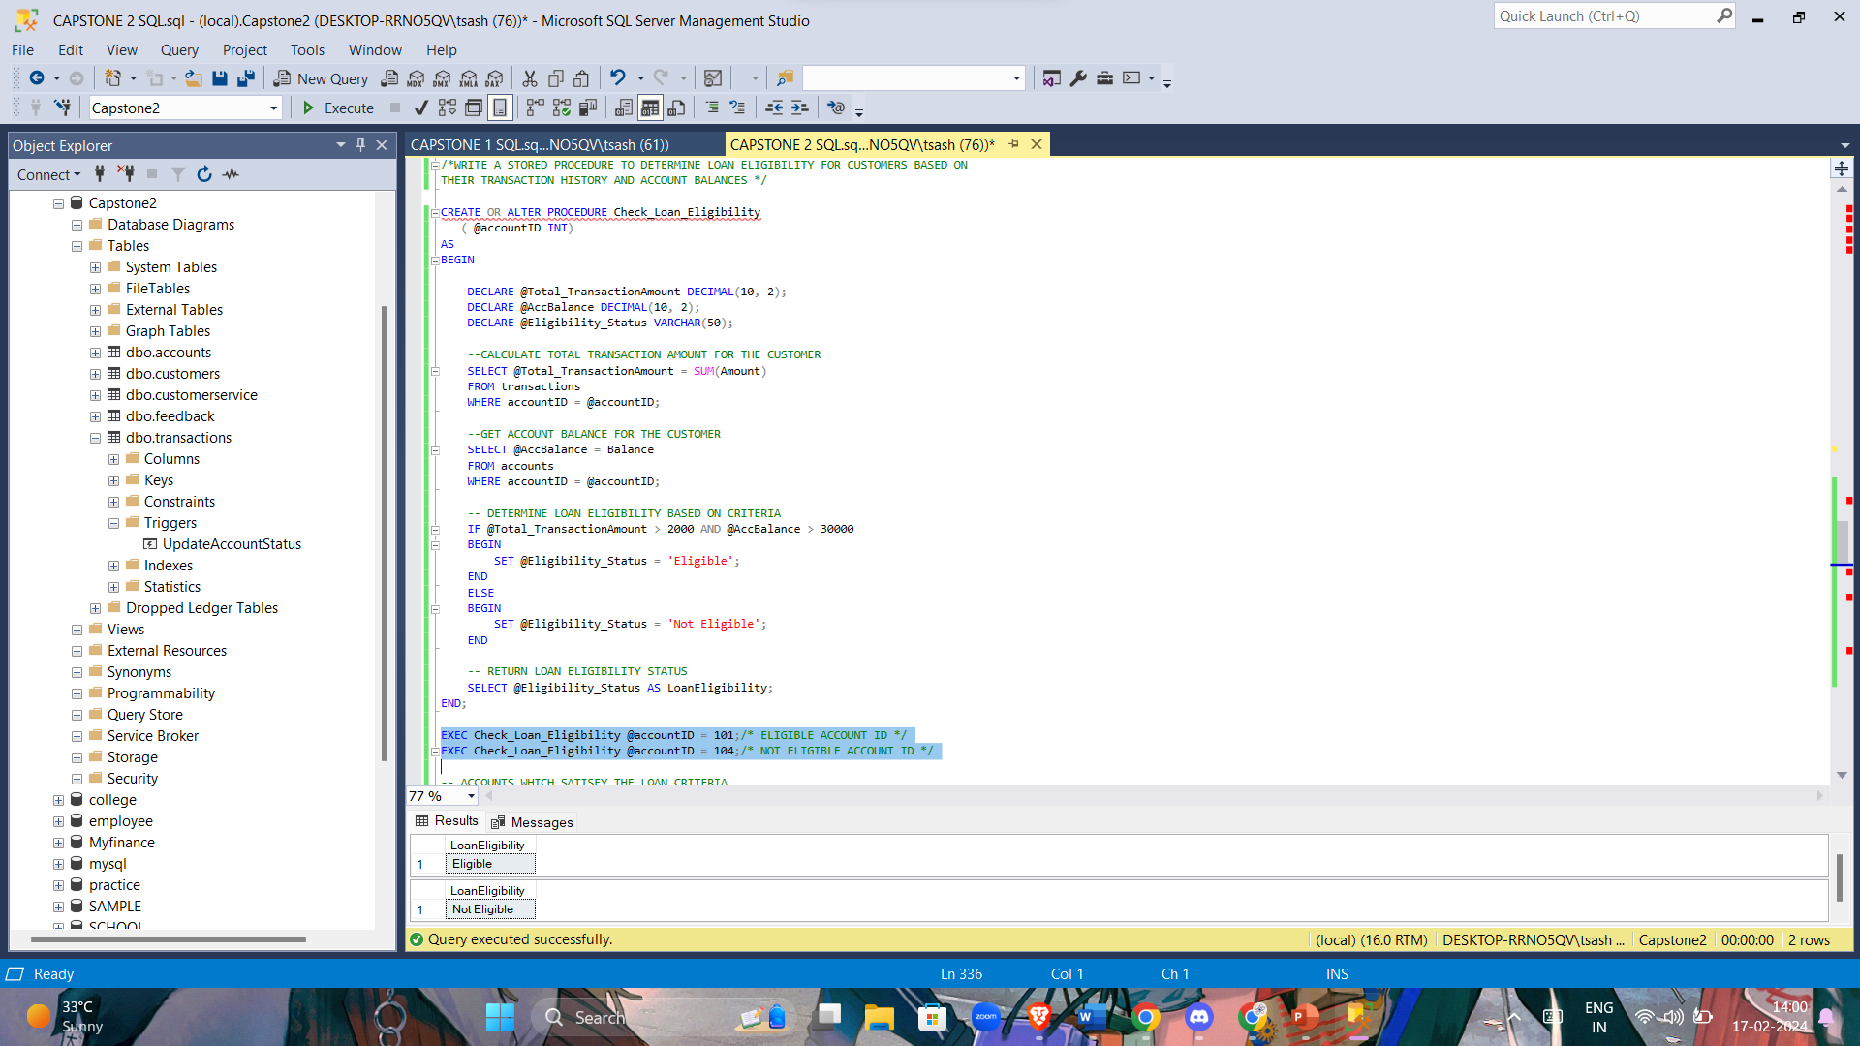
Write a stored procedure to determine loan eligibility for customers based on their transaction history and account balances.

Slide 15
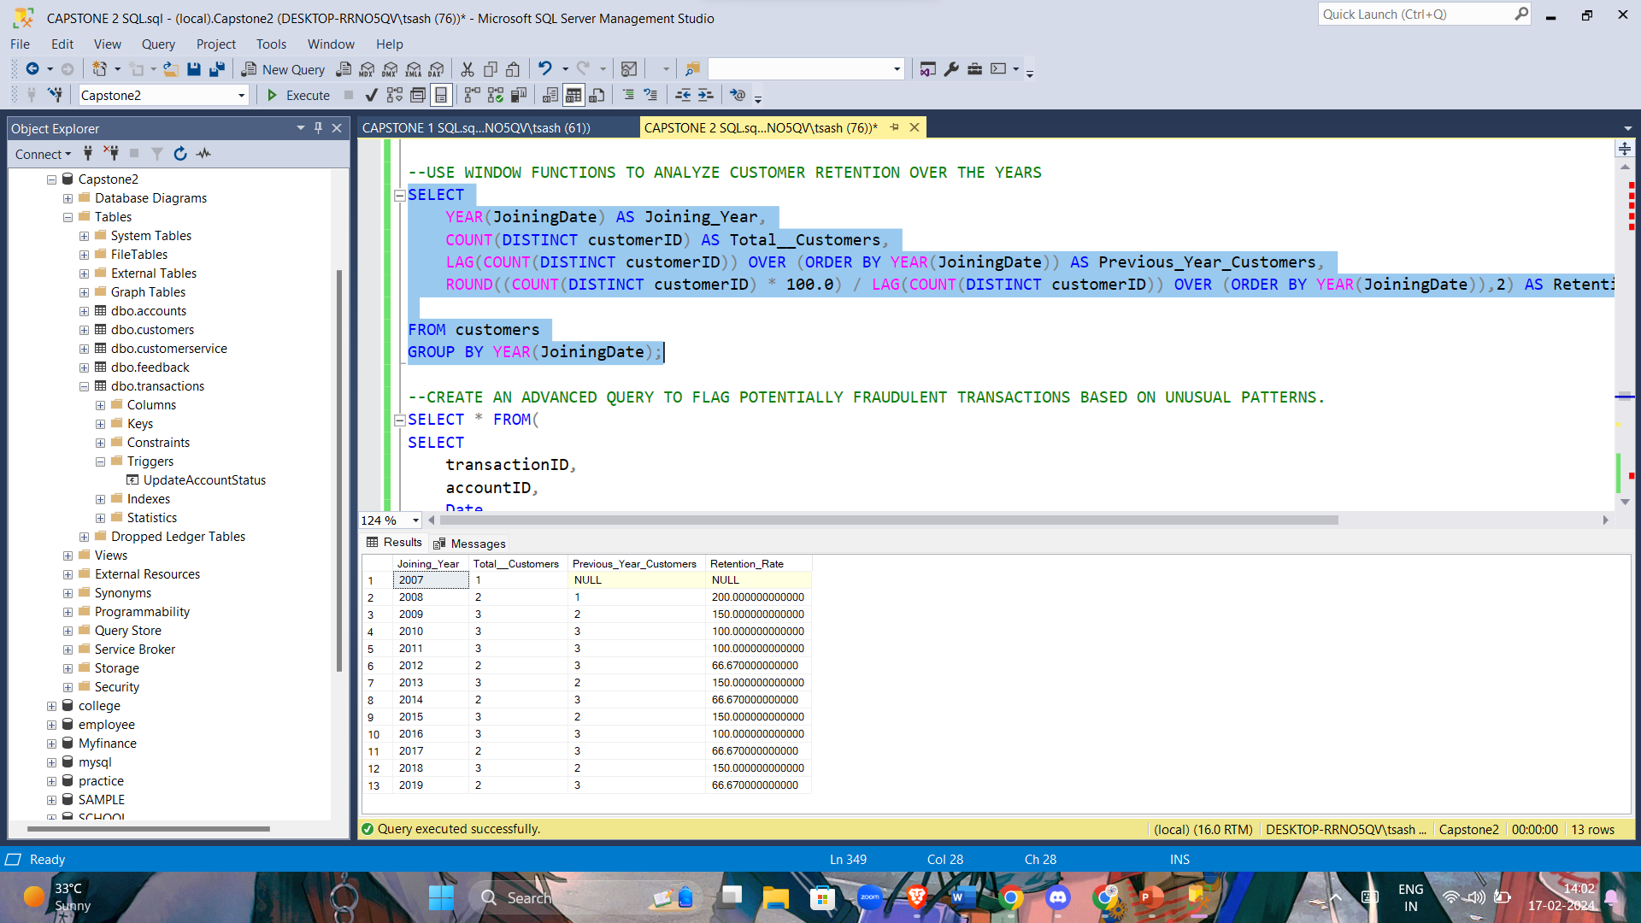
Use window functions to analyze customer retention over the years.

Slide 16
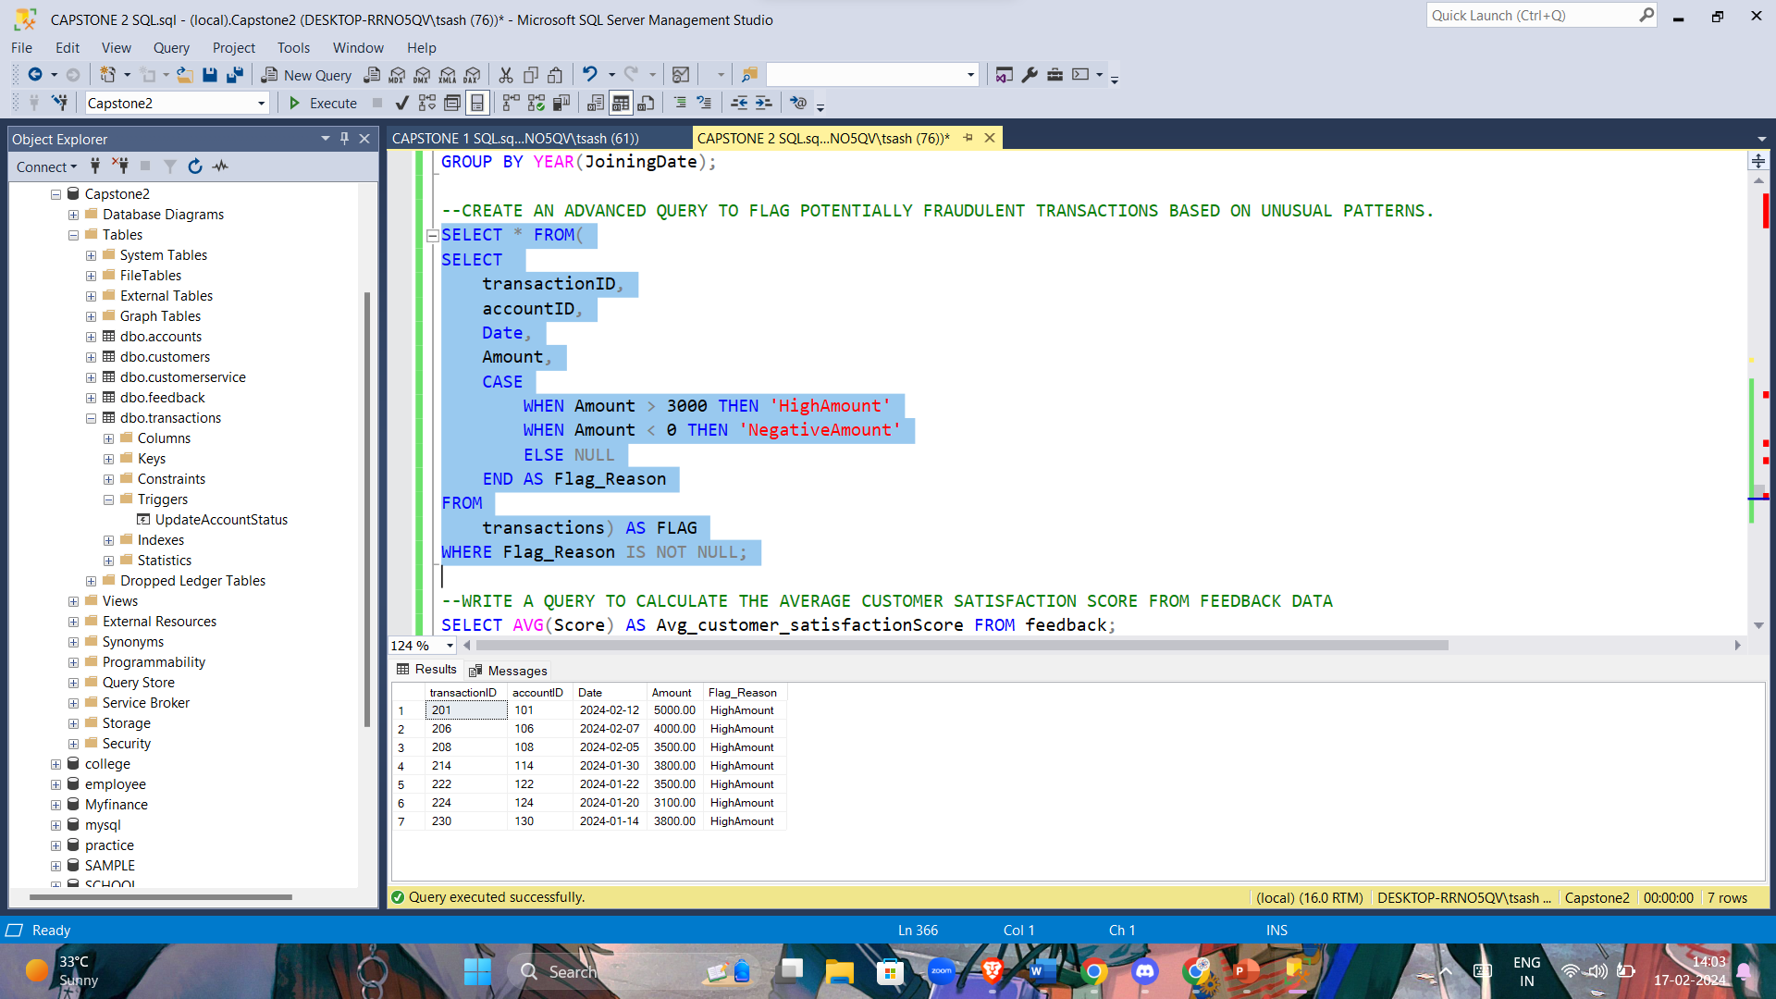
Create an advanced query to flag potentially fraudulent transactions based on unusual patterns.

Slide 17
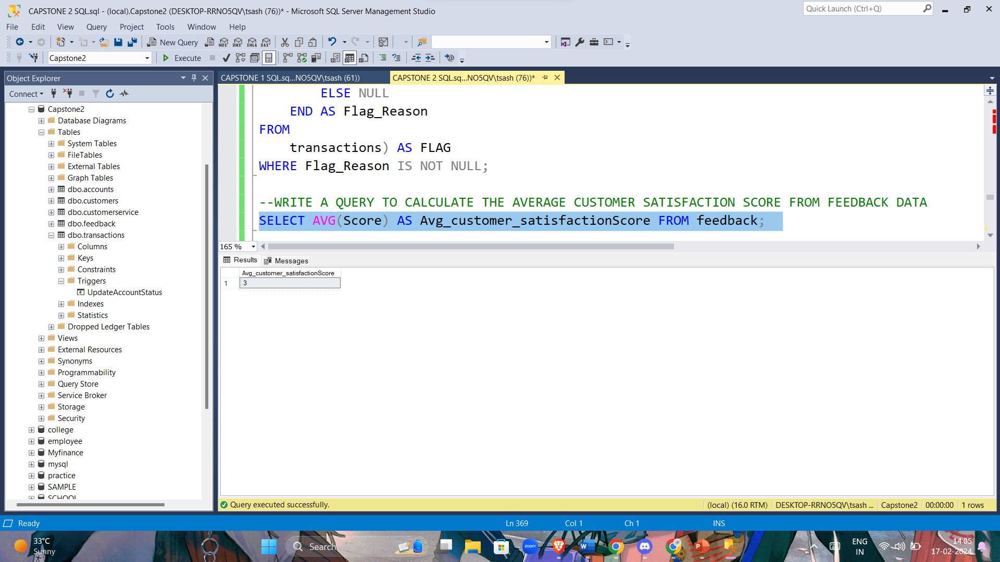
Write a query to calculate the average customer satisfaction score from feedback data.

Slide 18
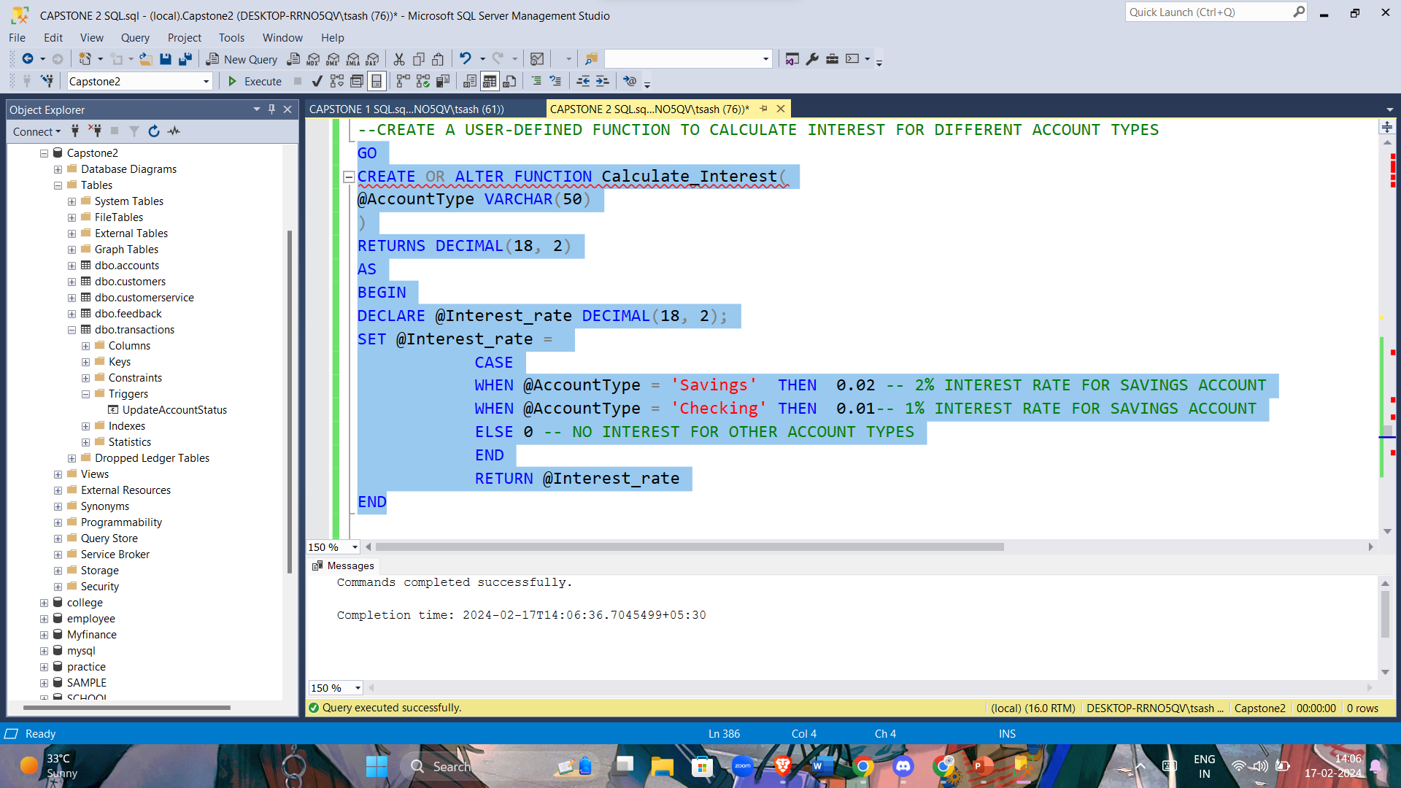
Create a user-defined function to calculate interest for different account types.

Slide 19
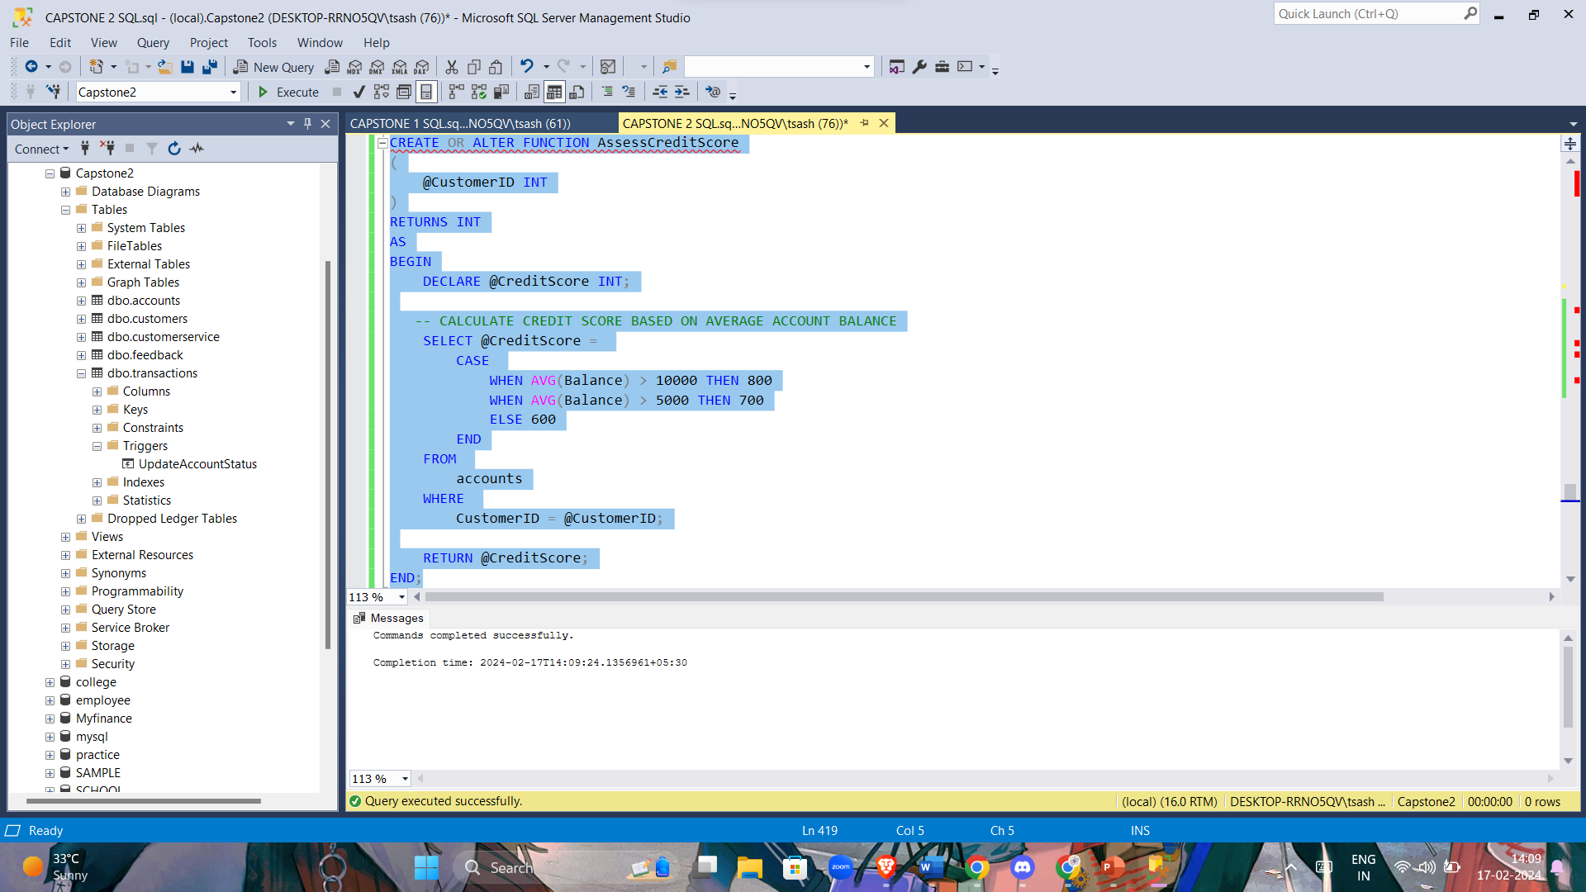
Develop a user-defined function to assess credit scores based on customer transaction history and account balances.

Slide 20
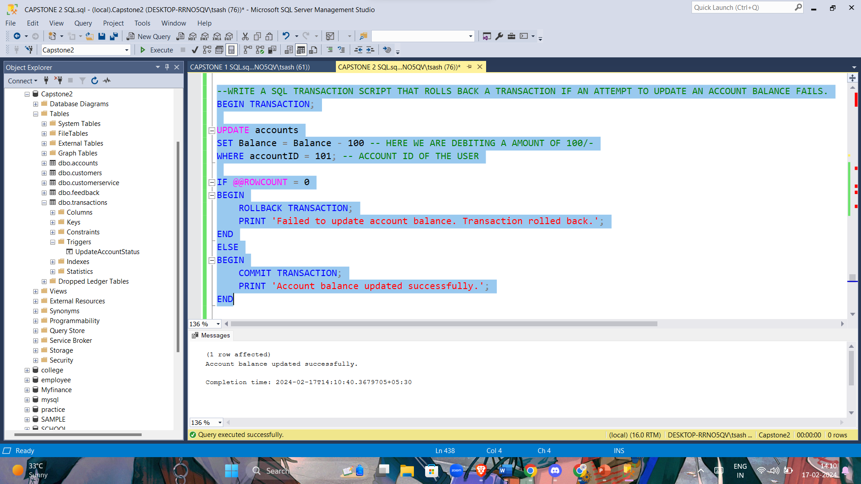
Write a SQL transaction script that rolls back a transaction if an attempt to update an account balance fails.

Slide 21
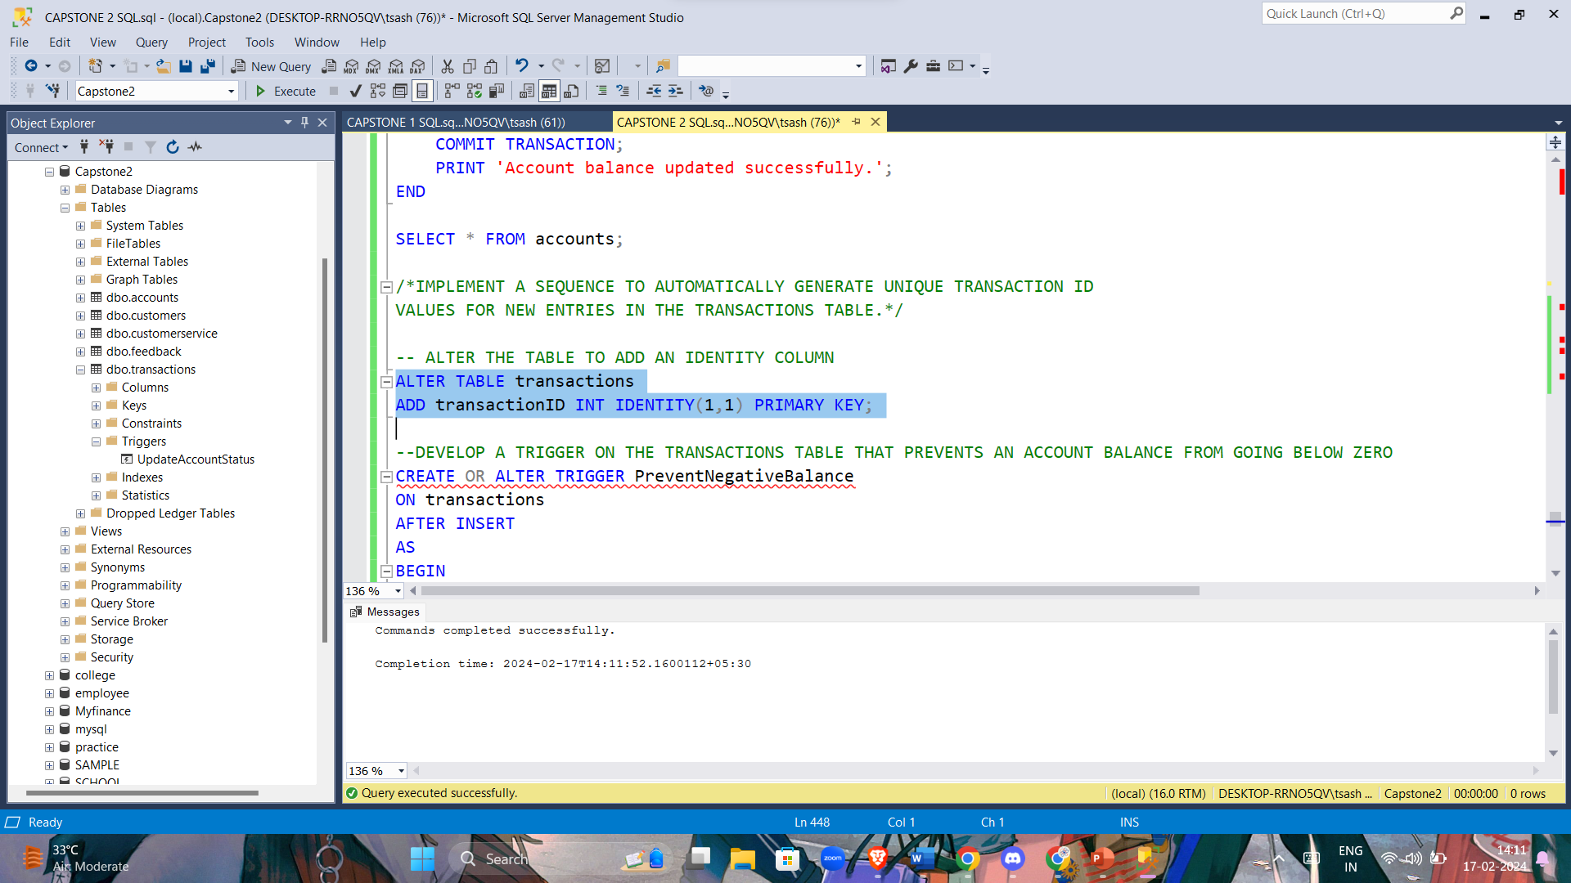
Implement a sequence to automatically generate unique TransactionID values for new entries in the Transactions table

Slide 22
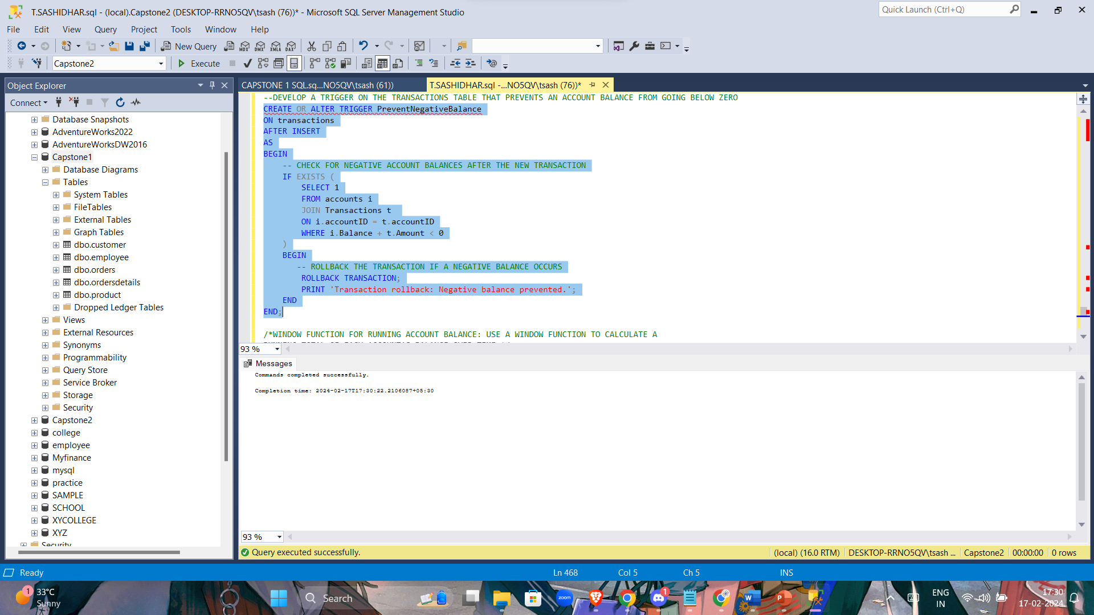
Develop a trigger on the Transactions table that prevents an account balance from going below zero.

Slide 23
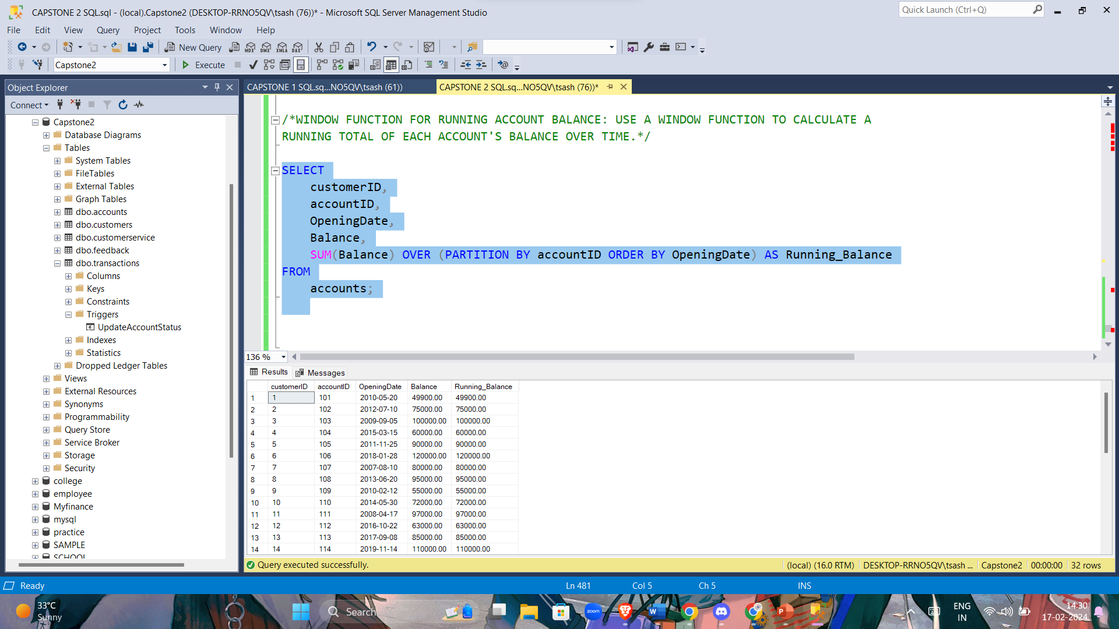
Window Function for Running Account Balance: Use a window function to calculate a running total of each account's balance over time.

Slide 24
THANK YOU

